Slide 1
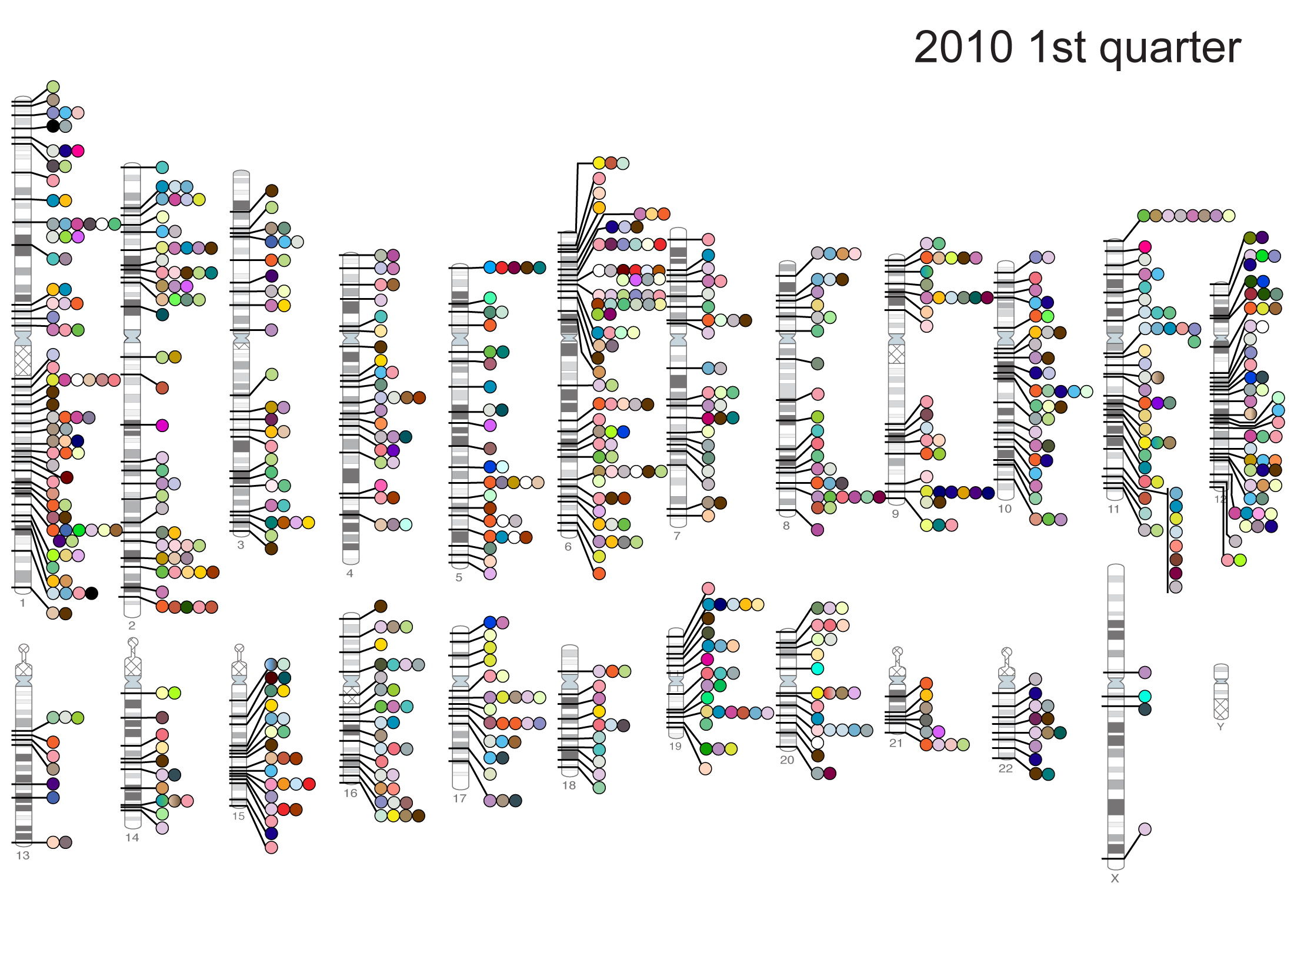
Published Genome-Wide Associations through 3/2010,
779 published GWA at p<5x10⁻⁸ for 148 traits
NHGRI GWA Catalog
www.genome.gov/GWAStudies

Slide 2
